Slide 1
Multimodal Depression Detection using Audio and Visual Features
Sachleen Singh Chani
x22244778
Supervisor: Dr. Muslim Jameel Syed

Slide 2
Introduction
Depression Detection lacks awareness
Single modality doesn’t get a complete understanding of the features
Multimodal system for depression classification
Proposed BiLSTM with attention model
Evaluating the model based on key metrics like false negative rates

Slide 3
Methodology
Audio feature extraction
Video feature extraction
Dataset creation
Single modality models: Random forest, LightGBM, FFNN
Multi-modal: BiLSTM with Attention layer
Evaluation based on key metrics

Slide 4
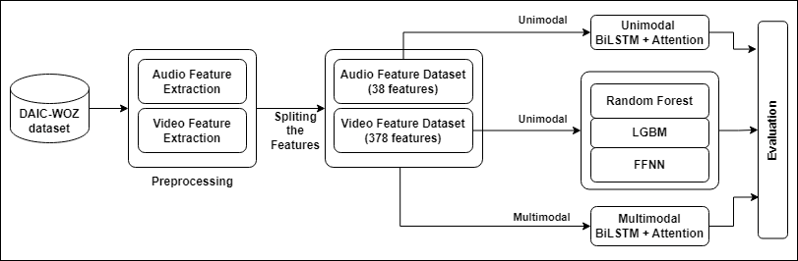
Research Design

Slide 5
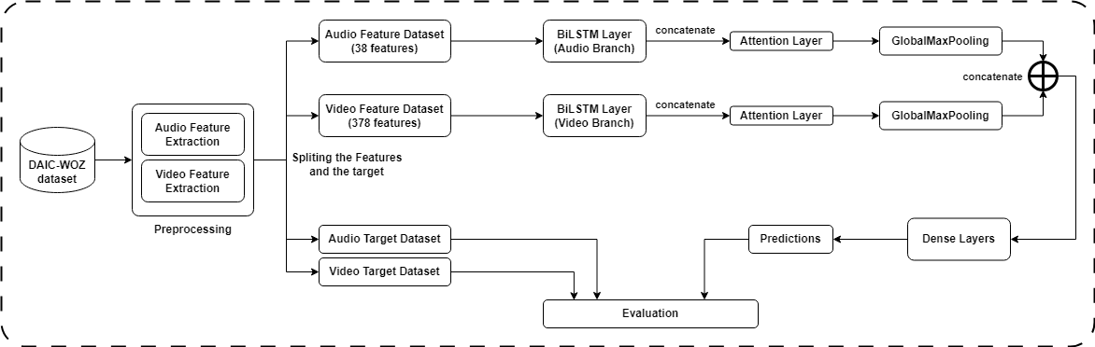
Proposed Model Design

Slide 6
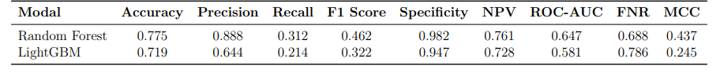
Evaluation and Results

Slide 7
Limitations and Future Scope
Limitations:
  Model only evaluated on one dataset
  High dependency on the data preprocessing
Future Scope:
  Incorporate text modality
  Use of pretrained models
  Increase generalization of the model through multiple datasets for training

Slide 8
Thank you

